Slide 1
Discrete Mathematics
Xiaowei Yang
School of Software Engineering
South China University of Technology
Office Room: B7-218
E-Mail Address: xwyang@scut.edu.cn

Slide 2
Chapter 1. The Foundations: Logic and Proofs
Propositional Equivalence
Section 1.2

Slide 3
Contents
1
Tautology (重言式) and Contradiction
2
Proofs with Truth Value Table
3
Proofs of Logical Equivalences

Slide 4
Tautology and Contradiction

Slide 5
Tautologies
A tautology is a compound proposition that is true no matter what the truth values of its atomic propositions are!
Ex. p ∨ ¬p [What is its truth table?]

Slide 6
Tautologies
When each row of the truth table gives T.
Example: p ∨ ¬p
T ¬ T=F
F ¬ F=T
T

Slide 7
Contradictions
A contradiction is a compound proposition that is false no matter what!
Ex. p ∧ ¬p [Truth table?]

Slide 8
Contradictions
When each row of the truth table gives F
Example: p ∧ ¬p
T ¬ T=F
F ¬ F=T
F

Slide 9
Proofs with Truth
Value Table

Slide 10
Propositional Equivalence
Two syntactically (i.e., textually) different compound propositions may be semantically identical (i.e., have the same meaning). We call them logically equivalent.
Notation: … ⇔ …

Slide 11
Logical Equivalence
Compound proposition p is logically equivalent to compound proposition q, written p⇔q, IFF p and q contain the same truth values
in all rows of their truth tables
We will also say: they express the same truth function (= the same function from values for atoms to values for the whole formula).

Slide 12
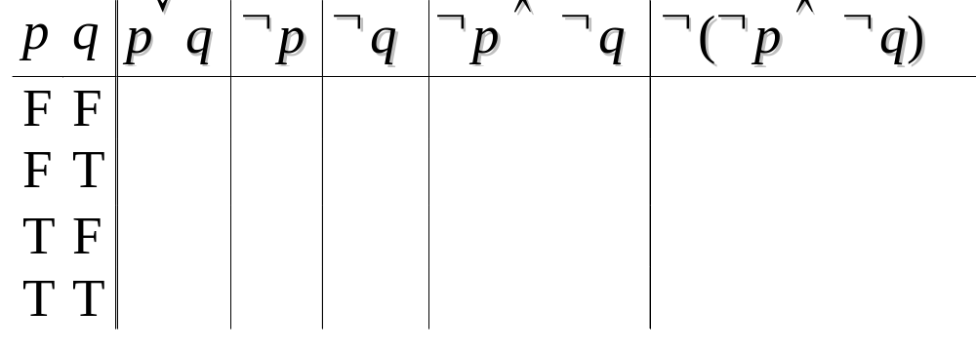
Example 2
Ex. Prove that p∨q ⇔ ¬(¬p ∧ ¬q).
F
T
T
T
F
T
T
F
F
T
T
F
T
F
T
T
F
F
F
T

Slide 13
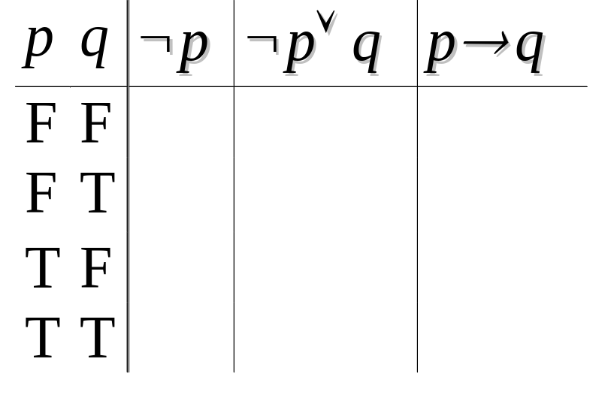
Example 3
Ex. Prove that ¬ p∨q ⇔ p → q.
T
T
T
T
T
T
F
F
F
F
T
T

Slide 14
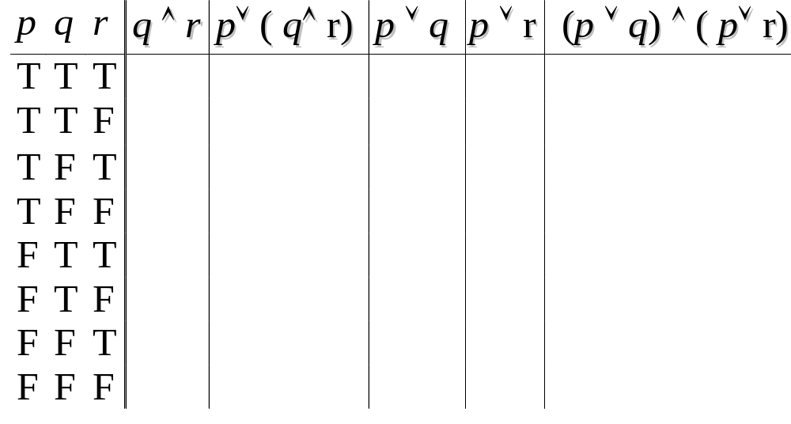
Example 4
Ex. Prove that p ∨ (q ∧ r)⇔ (p ∨ q) ∧ (p ∨ r) .
T
T
T
T
T
F
T
T
T
T
F
T
T
T
T
F
T
T
T
T
T
T
T
T
T
F
F
T
F
F
F
F
F
T
F
F
F
F
F
F

Slide 15
Questions for you to think about
Consider a conjunction p₁ ∧ p₂ ∧ p₃
How many rows are there in its truth table?
Consider a conjunction
p₁ ∧ p₂ ∧ … ∧ p_{n} of n propositions.
How many rows are there in its truth table?
Notes:
Note that AND is commutative and associative, which means that we can write a long conjunction (like in the first bullet on the left) without parenthesizing it. It also doesn’t matter what order the n propositions are in.
The fact that an n-operand operator has 2^n rows in its truth table is an easy consequence of the product rule of combinatorics. Here is a proof. Note that for the table to be complete, we must have 1 row for every possible assignment of truth values to the n operands. Thus, there is 1 row for every function f:V->B, where V is the set of operand columns {p,q,…} and B={T,F}. Here, |V|=n and |B|=2. The number of functions from a set of size n to a set of size m is m^n. This is because of the product rule, as we will see in a moment. In this case, m=2 so we get 2^n such functions. In terms of the product rule: There are 2 possible values for p. For each of these, there are 2 possible values for q, since the choice of q is independent of the choice of p. And so on. So there are 2x2x…(n repetitions)…x2 possible rows, thus 2^n. Of course, we haven’t defined the product rule, set cardinality, or functions yet, so don’t worry if the above argument doesn’t quite make sense to you yet.
In the second bullet, we would say, {NOT,AND} is a universal set of Boolean operators, but we haven’t even defined sets yet. If you already know what a set is, a universal set of operators over a given domain is a set of operators such that nested expressions involving those operators are sufficient to express any possible operator over that domain. In this case, the domain is B={T,F}. The proof that {NOT,AND} is universal is as follows: OR can be defined by p OR q = NOT(NOT(p) AND NOT(q)) (easily verified; this is one of DeMorgan’s Laws, which we will get to later). Now, armed with OR, AND, and NOT, we can show how to express any Boolean truth table, with any number of columns, as follows. Look for the cases where the last (result) column is T. For each such row in the truth table, include a corresponding term in a disjunctive expression for the whole truth table. The term should be a conjunction of terms, one for each input operand in that row. Each of these terms should be p if the entry in that position is “T”, and NOT(p) if the entry in that position is “F”. So, the entire expression basically says, “the value of the operator is T if and only if the pattern of truth values of the input operands exactly matches one of the rows in the truth table that ends in a ‘T’ result.” Thus, the expression directly encodes the content of the truth table.

Slide 16
Questions for you to think about
Consider a conjunction p₁ ∧ p₂ ∧ p₃
How many rows are there in its truth table? 8
p₁ ∧ p₂ ∧ p₃
1 1 1
1 1 0
1 0 1
1 0 0
0 1 1
0 1 0
0 0 1
0 0 0
Notes:
Note that AND is commutative and associative, which means that we can write a long conjunction (like in the first bullet on the left) without parenthesizing it. It also doesn’t matter what order the n propositions are in.
The fact that an n-operand operator has 2^n rows in its truth table is an easy consequence of the product rule of combinatorics. Here is a proof. Note that for the table to be complete, we must have 1 row for every possible assignment of truth values to the n operands. Thus, there is 1 row for every function f:V->B, where V is the set of operand columns {p,q,…} and B={T,F}. Here, |V|=n and |B|=2. The number of functions from a set of size n to a set of size m is m^n. This is because of the product rule, as we will see in a moment. In this case, m=2 so we get 2^n such functions. In terms of the product rule: There are 2 possible values for p. For each of these, there are 2 possible values for q, since the choice of q is independent of the choice of p. And so on. So there are 2x2x…(n repetitions)…x2 possible rows, thus 2^n. Of course, we haven’t defined the product rule, set cardinality, or functions yet, so don’t worry if the above argument doesn’t quite make sense to you yet.
In the second bullet, we would say, {NOT,AND} is a universal set of Boolean operators, but we haven’t even defined sets yet. If you already know what a set is, a universal set of operators over a given domain is a set of operators such that nested expressions involving those operators are sufficient to express any possible operator over that domain. In this case, the domain is B={T,F}. The proof that {NOT,AND} is universal is as follows: OR can be defined by p OR q = NOT(NOT(p) AND NOT(q)) (easily verified; this is one of DeMorgan’s Laws, which we will get to later). Now, armed with OR, AND, and NOT, we can show how to express any Boolean truth table, with any number of columns, as follows. Look for the cases where the last (result) column is T. For each such row in the truth table, include a corresponding term in a disjunctive expression for the whole truth table. The term should be a conjunction of terms, one for each input operand in that row. Each of these terms should be p if the entry in that position is “T”, and NOT(p) if the entry in that position is “F”. So, the entire expression basically says, “the value of the operator is T if and only if the pattern of truth values of the input operands exactly matches one of the rows in the truth table that ends in a ‘T’ result.” Thus, the expression directly encodes the content of the truth table.

Slide 17
Questions for you to think about
2. Consider p₁ ∧ p₂ ∧ … ∧ p_{n}
How many rows are there
in its truth table?
2.2.2. … .2 (n factors)
Hence 2^{n} (This grows exponentially!)
Notes:
Note that AND is commutative and associative, which means that we can write a long conjunction (like in the first bullet on the left) without parenthesizing it. It also doesn’t matter what order the n propositions are in.
The fact that an n-operand operator has 2^n rows in its truth table is an easy consequence of the product rule of combinatorics. Here is a proof. Note that for the table to be complete, we must have 1 row for every possible assignment of truth values to the n operands. Thus, there is 1 row for every function f:V->B, where V is the set of operand columns {p,q,…} and B={T,F}. Here, |V|=n and |B|=2. The number of functions from a set of size n to a set of size m is m^n. This is because of the product rule, as we will see in a moment. In this case, m=2 so we get 2^n such functions. In terms of the product rule: There are 2 possible values for p. For each of these, there are 2 possible values for q, since the choice of q is independent of the choice of p. And so on. So there are 2x2x…(n repetitions)…x2 possible rows, thus 2^n. Of course, we haven’t defined the product rule, set cardinality, or functions yet, so don’t worry if the above argument doesn’t quite make sense to you yet.
In the second bullet, we would say, {NOT,AND} is a universal set of Boolean operators, but we haven’t even defined sets yet. If you already know what a set is, a universal set of operators over a given domain is a set of operators such that nested expressions involving those operators are sufficient to express any possible operator over that domain. In this case, the domain is B={T,F}. The proof that {NOT,AND} is universal is as follows: OR can be defined by p OR q = NOT(NOT(p) AND NOT(q)) (easily verified; this is one of DeMorgan’s Laws, which we will get to later). Now, armed with OR, AND, and NOT, we can show how to express any Boolean truth table, with any number of columns, as follows. Look for the cases where the last (result) column is T. For each such row in the truth table, include a corresponding term in a disjunctive expression for the whole truth table. The term should be a conjunction of terms, one for each input operand in that row. Each of these terms should be p if the entry in that position is “T”, and NOT(p) if the entry in that position is “F”. So, the entire expression basically says, “the value of the operator is T if and only if the pattern of truth values of the input operands exactly matches one of the rows in the truth table that ends in a ‘T’ result.” Thus, the expression directly encodes the content of the truth table.

Slide 18
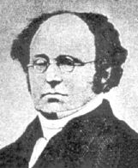
De Morgan’s laws
¬(p1 ∨ p2… ∨ pn)= ¬p1 ∧ ¬ p2… ∧ ¬ pn
¬(p1 ∧ p2… ∧ pn)= ¬p1 ∨ ¬ p2… ∨ ¬ pn
¬(p ∨ q)= ¬ p ∧ ¬ q
¬(p ∧ q)= ¬ p ∨ ¬ q
Augustus
De Morgan
(1806-1871)

Slide 19
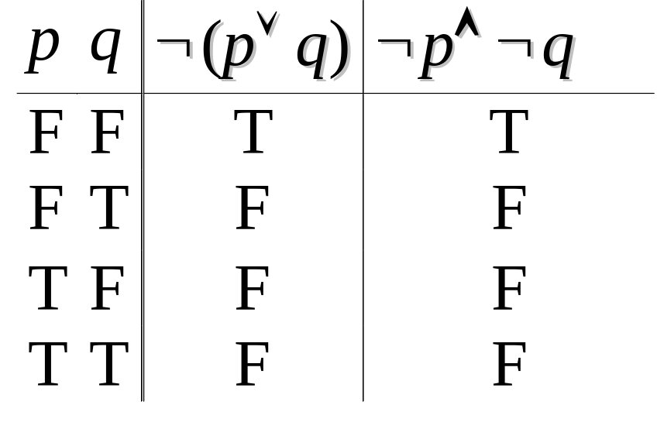
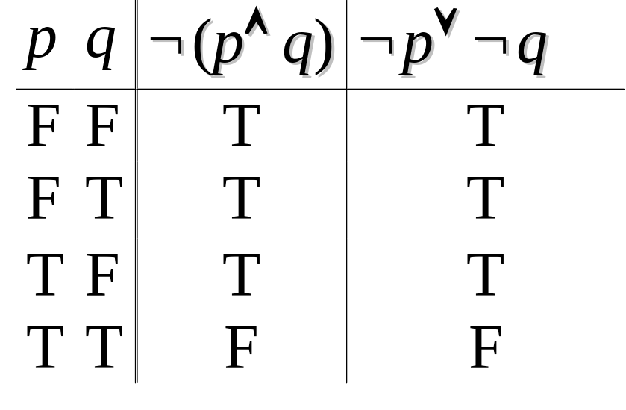
Truth Table for De Morgan’s Law

Slide 20
Equivalence Laws - Examples
Identity: p∧T ⇔ p p∨F ⇔ p
Domination: p∨T ⇔ T p∧F ⇔ F
Idempotence(幂等): p∨p ⇔ p p∧p ⇔ p
Double negation: ¬¬p ⇔ p
Commutativity: p∨q ⇔ q∨p p∧q ⇔ q∧p
Associativity: (p∨q)∨r ⇔ p∨(q∨r)
(p∧q)∧r ⇔ p∧(q∧r)

Slide 21
More Equivalence Laws
Distributive: p∨(q∧r) ⇔ (p∨q)∧(p∨r)
p∧(q∨r) ⇔ (p∧q)∨(p∧r)
De Morgan’s:
¬(p∧q) ⇔ ¬p ∨ ¬q
¬(p∨q) ⇔ ¬p ∧ ¬q
Trivial tautology/contradiction:
p ∨ ¬p ⇔ T p ∧ ¬p ⇔ F
Augustus
De Morgan
(1806-1871)

Slide 22
Logical Equivalence Involving Implications
p → q ⇔ ¬p ∨ q p → q ⇔ ¬q → ¬p
p ∨ q ⇔ ¬p → q p ∧ q ⇔ ¬(p → ¬q)
¬(p → q) ⇔ p ∧ ¬ q
(p → q) ∧ (p → r) ⇔ p → (q ∧ r)
(p → r) ∧ (q → r) ⇔ (p ∨ q) → r
(p → q) ∨ (p → r) ⇔ p → (q ∨ r)
(p → r) ∨ (q → r) ⇔ (p ∧ q) → r

Slide 23
(p → q) ∧ (p → r) ⇔ p → (q ∧ r)
(p → q) ∧ (p → r)
⇔ (¬ p ∨ q) ∧ (¬ p ∨ r)
⇔ ¬ p ∨ (q ∧ r )
⇔ p → (q ∧ r)
Distributive: p∨(q∧r) ⇔ (p∨q)∧(p∨r)
p∧(q∨r) ⇔ (p∧q)∨(p∧r)

Slide 24
(p → r) ∧ (q → r) ⇔ (p ∨ q) → r
(p → r) ∧ (q → r)
⇔ (¬ p ∨ r) ∧ (¬ q ∨ r)
⇔ r ∨ (¬ p ∧ ¬ q )
⇔ r ∨ ¬ (p ∨ q )
⇔ ¬ (p ∨ q ) ∨ r
⇔ (p ∨ q) → r
Distributive

Slide 25
(p → q) ∨ (p → r) ⇔ p → (q ∨ r)
(p → q) ∨ (p → r)
⇔ (¬ p ∨ q) ∨ (¬ p ∨ r)
⇔ ¬ p ∨ (q ∨ r)
⇔ p → (q ∨ r)
Distributive

Slide 26
(p → r) ∨ (q → r) ⇔ (p ∧ q) → r
(p → r) ∨ (q → r)
⇔ (¬ p ∨ r) ∨ (¬ q ∨ r)
⇔ r ∨ (¬ p ∨ ¬ q )
⇔ r ∨ ¬ (p ∧ q )
⇔ ¬ (p ∧ q ) ∨ r
⇔ (p ∧ q) → r

Slide 27
Logical Equivalence Involving Biconditionals
p ↔ q ⇔ (p → q) ∧ (q → p)
p ↔ q ⇔ ¬ p ↔ ¬ q
p ↔ q ⇔ (p ∧ q) ∨ (¬ p ∧ ¬ q)
¬ (p ↔ q) ⇔ p ↔ ¬ q

Slide 28
p ↔ q ⇔ (p → q) ∧ (q → p)
(p → q) ∧ (q → p)
⇔ (¬ p ∨ q) ∧ (¬ q ∨ p)
= T if p=q or F if p and q are different
So (¬ p ∨ q) ∧ (¬ q ∨ p) ⇔ p ↔ q

Slide 29
p ↔ q ⇔ ¬ p ↔ ¬ q
¬ p ↔ ¬ q
⇔ (¬ p → ¬ q) ∧ (¬ q → ¬ p)
⇔ (¬ ¬ p ∨ ¬ q) ∧ (¬ ¬ q ∨ ¬ p)
⇔ ( p ∨ ¬ q) ∧ (q ∨ ¬ p)
⇔ (q → p) ∧ (p → q)
⇔ p ↔ q

Slide 30
p ↔ q ⇔ (p ∧ q) ∨ (¬ p ∧ ¬ q)
p ↔ q
⇔ (p → q) ∧ (q → p)
⇔ (¬ p ∨ q) ∧ (¬ q ∨ p)
⇔ ((¬ p ∨ q) ∧ ¬ q ) ∨ ((¬ p ∨ q) ∧ p )
⇔ (¬p∧¬q)∨(q ∧¬q)∨ (¬p∧p)∨(q ∧ p)
⇔ (¬p ∧ ¬q) ∨ F ∨ F ∨ (q ∧ p)
⇔ (q ∧ p) ∨(¬p ∧ ¬q)
The first approach of Proof

Slide 31
p ↔ q ⇔ (p ∧ q) ∨ (¬ p ∧ ¬ q)
p ↔ q
⇔ (p → q) ∧ (q → p)
⇔ (¬ p ∨ q) ∧ (¬ q ∨ p)
⇔ ((¬ p ∨ q) ∧ T ) ∧ ((¬ q ∨ p) ∧ T )
⇔ (¬p ∨ q)∧(¬ p ∨ p) ∧ (¬q ∨ p) ∧ (¬q ∨ q)
⇔ (¬p ∨ (p ∧ q)) ∧ (¬q ∨ (p ∧ q))
⇔ (q ∧ p) ∨(¬p ∧ ¬q)
The second approach of Proof

Slide 32
¬ (p ↔ q) ⇔ p ↔ ¬ q
¬ (p ↔ q)
⇔ ¬((q ∧ p) ∨(¬p ∧ ¬q))
⇔ ¬(q ∧ p) ∧ ¬ (¬p ∧ ¬q)
⇔ (¬q ∨ ¬ p) ∧ (p ∨ q)
p ↔ ¬ q
⇔ (p ∧ ¬q) ∨(¬p ∧ q)
⇔ ((p ∧ ¬q) ∨ F) ∨ ((¬p ∧ q) ∨ F)
⇔ ((p∧¬q)∨(¬p∧p)) ∨ ((¬p∧q)∨(¬q∧q))
⇔ p ∧ (¬p ∨ ¬q) ∨ q ∧ (¬p ∨ ¬q)
(¬q ∨ ¬ p) ∧ (p ∨ q)

Slide 33
Defining Operators via Equivalences
Some equivalences can be thought as definitions of one operator in terms of others:
Exclusive or: p⊕q ⇔ (p∨q)∧¬(p∧q)
p⊕q ⇔ (p∧¬q)∨(q∧¬p)
Implies: p→q ⇔ ¬p ∨ q
Biconditional: p↔q ⇔ (p→q) ∧ (q→p)
p↔q ⇔ ¬(p⊕q)

Slide 34
p ⊕ q ⇔ (p ∨ q) ∧ ¬( p ∧ q )
p ⊕ q
⇔ ¬ (p ↔ q)
⇔ ¬((q ∧ p) ∨(¬p ∧ ¬q))
⇔ ¬(q ∧ p) ∧ ¬ (¬p ∧ ¬q)
⇔ (¬q ∨ ¬ p) ∧ (p ∨ q)
⇔ ¬ (q ∧ p) ∧ (p ∨ q)

Slide 35
p ⊕ q ⇔ ( p ∧ ¬q )∨( q ∧ ¬p)
( p ∧¬ q ) ∨ ( q ∧ ¬p )
⇔ ¬ (¬ (( p ∧¬ q ) ∨ ( q ∧ ¬p )))
⇔ ¬ (¬ ( p ∧¬ q ) ∧ ¬ ( q ∧ ¬p ))
⇔ ¬ ((¬ p ∨ q) ∧ (¬q ∨ p))
⇔ ¬ ((p → q) ∧ (q → p))
⇔ ¬ (p ↔ q)
⇔ p ⊕ q

Slide 36
Example 1
¬(p ∨ (¬p ∧ q)) ⇔ ¬p ∧ ¬q ?
¬(p ∨ (¬p ∧ q))
⇔ ¬p ∧ ¬(¬p ∧ q)
⇔ ¬p ∧ ( p ∨ ¬ q )
⇔ ¬p ∧ p ∨ ¬p ∧ ¬ q
⇔ F ∨ ¬p ∧ ¬ q
⇔ ¬p ∧ ¬ q

Slide 37
Example 2
( p ∧ q ) → p ∨ q ⇔ T
( p ∧ q ) → p ∨ q
⇔ ¬ (p ∧ q) ∨ (p ∨ q)
⇔ (¬ p ∨ ¬ q) ∨ (p ∨ q)
⇔ ¬ p ∨ ¬ q ∨ p ∨ q
⇔ ¬ p ∨ p ∨ ¬ q ∨ q
⇔ T ∨ T
⇔ T

Slide 38
Example 3
Use equivalences to prove that
(p ∧ ¬q) → (p ⊕ r) ⇔ ¬p ∨ q ∨ ¬r.
(This would be much easier using truth tables!)
(p ∧ ¬q) → (p ⊕ r) [Expand “definition” of →]
⇔ ¬(p ∧ ¬q) ∨ (p ⊕ r) [Expand “definition” of ⊕]
⇔ ¬(p ∧ ¬q) ∨ ((p ∨ r) ∧ ¬(p ∧ r)) [DeMorgan]
⇔ (¬p ∨ q) ∨ ((p ∨ r) ∧ ¬(p ∧ r))
cont.

Slide 39
Long example Continued...
(¬p ∨ q) ∨ ((p ∨ r) ∧ ¬(p ∧ r)) ⇔ [∨ commutes]
⇔ (q ∨ ¬p) ∨ ((p ∨ r) ∧ ¬(p ∧ r)) [∨ is associative]
⇔ q ∨ (¬p ∨ ((p ∨ r) ∧ ¬(p ∧ r))) [distrib. ∨ over ∧]
q ∨ (((¬p ∨ (p ∨ r)) ∧ (¬p ∨ ¬(p ∧ r))) [assoc.]
q ∨ (((¬p ∨ p) ∨ r) ∧ (¬p ∨ ¬(p ∧ r))) [taut.]
q ∨ ((T ∨ r) ∧ (¬p ∨ ¬(p ∧ r))) [domination]
q ∨ (T ∧ (¬p ∨ ¬(p ∧ r))) [identity]
⇔ q ∨ (¬p ∨ ¬(p ∧ r)) ⇔ cont.

Slide 40
End of Long Example
q ∨ (¬p ∨ ¬(p ∧ r)) [DeMorgan]
q ∨ (¬p ∨ (¬p ∨ ¬r)) [Assoc.]
q ∨ ((¬p ∨ ¬p) ∨ ¬r) [Idempotent]
q ∨ (¬p ∨ ¬r) [Associativity]
(q ∨ ¬p) ∨ ¬r [Commutativity]
⇔ ¬p ∨ q ∨ ¬r

Slide 41
工作派遣问题
某项工作需要派A、B、C和D 4个人中的2个人去完成，按下面3个条件，有几种派法？如何派？
(1)若A去，则C和D中要去1个人；
(2)B和C不能都去；
(3)若C去，则D留下。

Slide 42
工作派遣问题
设A：A去工作；B：B去工作；C：C去工作；D：D去工作。则根据题意应有：A→C⊕D，¬(B∧C)，C→¬D必须同时成立。因此
(A→C⊕D)∧¬(B∧C)∧(C→¬D)
<=>(¬A∨(C∧¬D)∨(¬C∧D))∧(¬B∨¬C)∧(¬C∨¬D)
使用分配律
<=>(¬ A∨(C∧¬D)∨(¬C∧D))∧((¬B∧¬C)∨(¬B∧¬D)∨¬C∨(¬C∧¬D))
使用分配律
<=> (¬A∧¬B∧¬C)∨(¬A∧¬B∧¬D)∨(¬A∧¬C)∨(¬A∧¬C∧¬D)
∨(C∧¬D∧¬B∧¬C)∨(C∧¬D∧¬B∧¬D)∨(C∧¬D∧¬C)∨(C∧¬D∧¬C∧¬D)∨(¬C∧D∧¬B∧¬C)∨(¬C∧D∧¬B∧¬D)∨(¬C∧D∧¬C)∨(¬C∧D∧¬C∧¬D)

Slide 43
工作派遣问题
化简 <=>F∨F∨(¬A∧¬C)∨F∨F∨(C∧¬D∧¬B)∨F∨F∨(¬C∧D∧¬B)∨F∨(¬ C∧D)∨F
<=>(¬ A∧¬C)∨(¬ B∧C∧¬D)∨(¬C∧D∧¬B)∨(¬ C∧D)
<=>(¬ A∧¬C)∨(¬ B∧C∧¬D)∨(¬C∧D)
<=>T
故有三种派法：B∧D，A∧C，A∧D。

Slide 44
命题推理问题
如果他是计算机系本科生或者是计算机系研究生，那么他一定学过DELPHI语言而且学过C++语言。只要他学过DELPHI语言或者C++语言，那么他就会编程序。因此如果他是计算机系本科生，那么他就会编程序。请用命题逻辑推理方法，证明该推理的有效结论。

Slide 45
命题推理问题
令p：他是计算机系本科生 q：他是计算机系研究生
r：他学过DELPHI语言 s:他学过C++语言 t:他会编程序
前提：(p∨q)→(r∧s),(r∨s)→t
结论：p→t
证：①p P(附加前提)
②p∨q ①
③(p∨q)→(r∧s) P(前提引入)
④r∧s ②③
⑤r ④
⑥r∨s ⑤
⑦(r∨s)→t P(前提引入)
⑧t ⑤⑥

Slide 46
Exercises
P22 5

Slide 47
End of the Section 1.2

